Slide 1
Planning Your Food Safety Practices in Your Vision for Growth April 9, 2022

Slide 3
1239 N. Hendricks---Farm
1540 W. 12^{th-----} Home

Slide 4
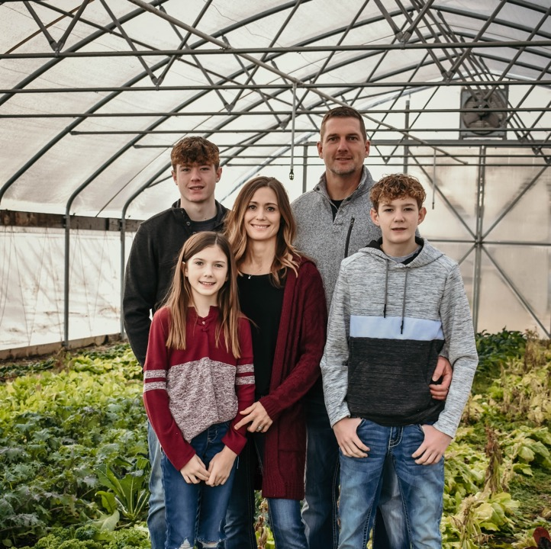
The Tecklenburgs teckfarms.com facebook/instagram
Hometown
Children
Jobs
Hobbies

Slide 5
Teck Farms est.2016 Urban Agriculture The Mission
TO MAKE NUTRITIOUS FOOD MORE AFFORDABLE AND ACCESSIBLE TO ALL
SERVE THE COMMUNITY
PROMOTE STEWARDSHIP
AND EDUCATE ON HEALTH AND WELLNESS

Slide 6
Glenwood Gardens Health and Wellness Foundation est. 2018 The mission
The Foundation will focus on promoting a healthy way of life
through the education of growing and consuming nutritious food

Slide 7
Urban Agriculture and Small Farms
Small farms have been critical to the fabric of American society through the Nation’s history.
Today, as historically, the vast majority of farms in the United States are small.
The viability and sustainability of these farms are important to our Nation’s economy, to the wise stewardship of natural resources, and to the leadership and social fabric of rural and urban communities.
Their economic contribution is important to the Nation and is especially critical to the economic and social vitality of thousands of rural urban communities.

Slide 8
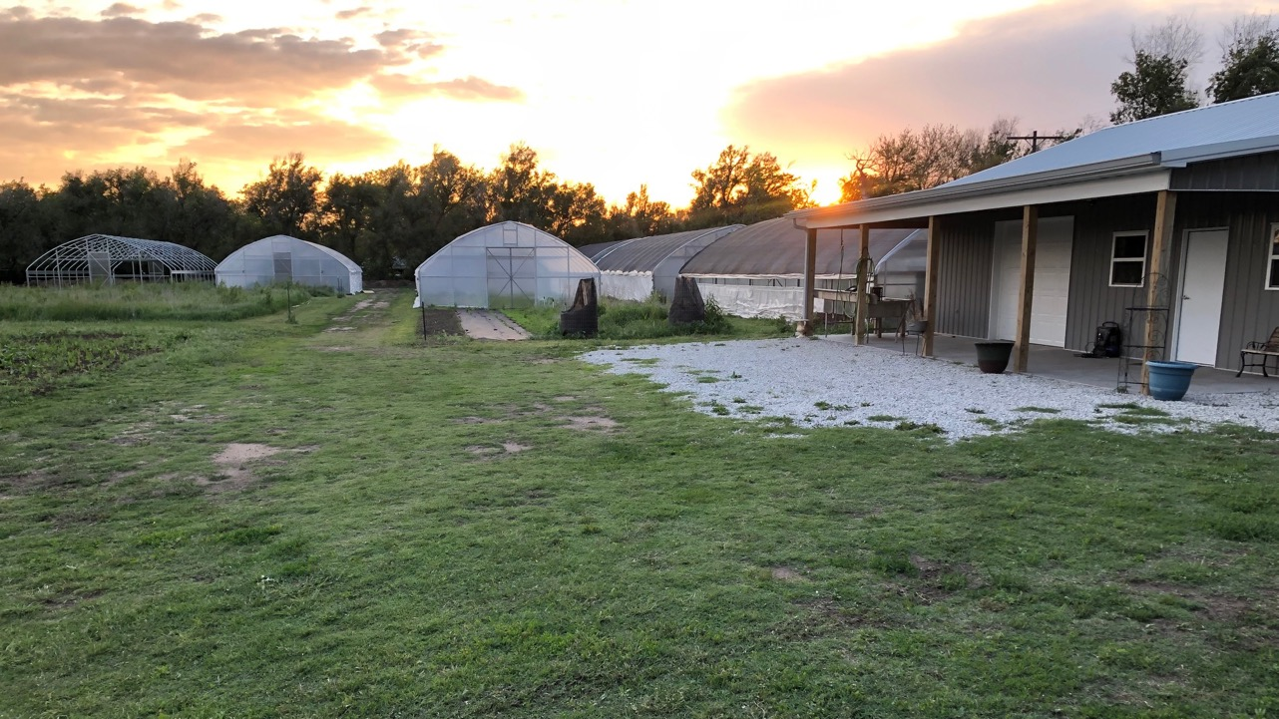
5.8 acres
7 High Tunnels (30x72) 2160 sq ft.
Post Harvest Facility 30x40
Certified Organic by Oklahoma Department of Agriculture, Food and Forestry

Slide 9
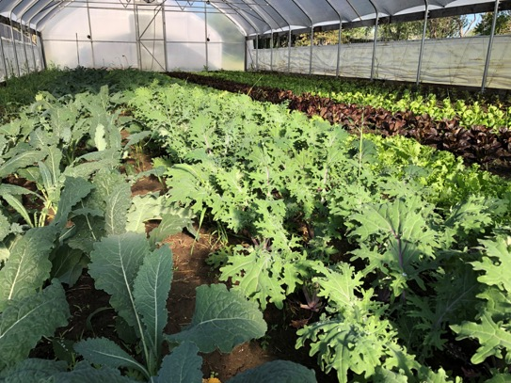
What is Organic
Record Keeping
No Synthetics
Regulations
Labor intensive
Soil Health
Good Stewardship

Slide 10
Organic Practices
Cover crop—outdoor and high tunnels

Slide 11
Organic Practices
Compost

Slide 12
Organic Practices
Chickens to prep and add nutrients

Slide 13
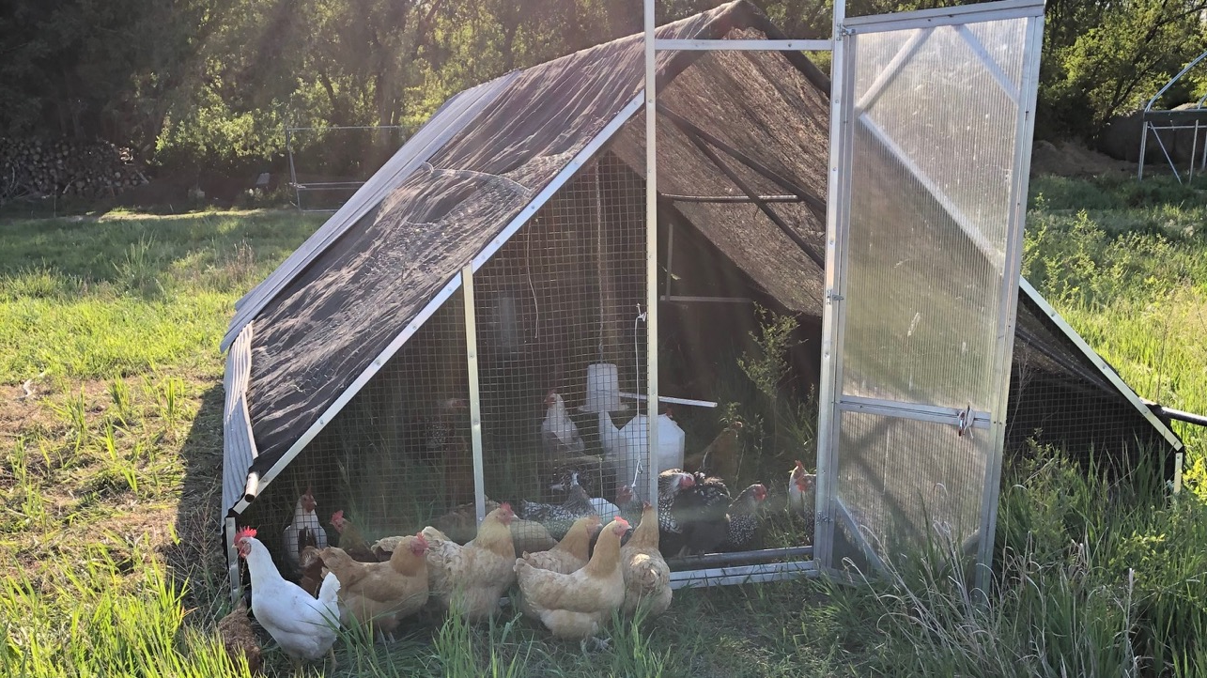
Chicken Tractor Manure goes where it is needed.

Slide 14
Food Safety Requirements
Per FSMA:
At this time, the FDA does not object to farmers complying with the USDA’s National Organic Program standards, which call for a 120-day interval between the application of raw manure for crops in contact with the soil and 90 days for crops not in contact with the soil.

Slide 15
Aerator 3-vat Sink System

Slide 16
Efficiency
Spin dry—the quicker from processing into the cooler, it will stay fresh longer

Slide 17
Measuring Success
Enjoyable
Profitable

Slide 18
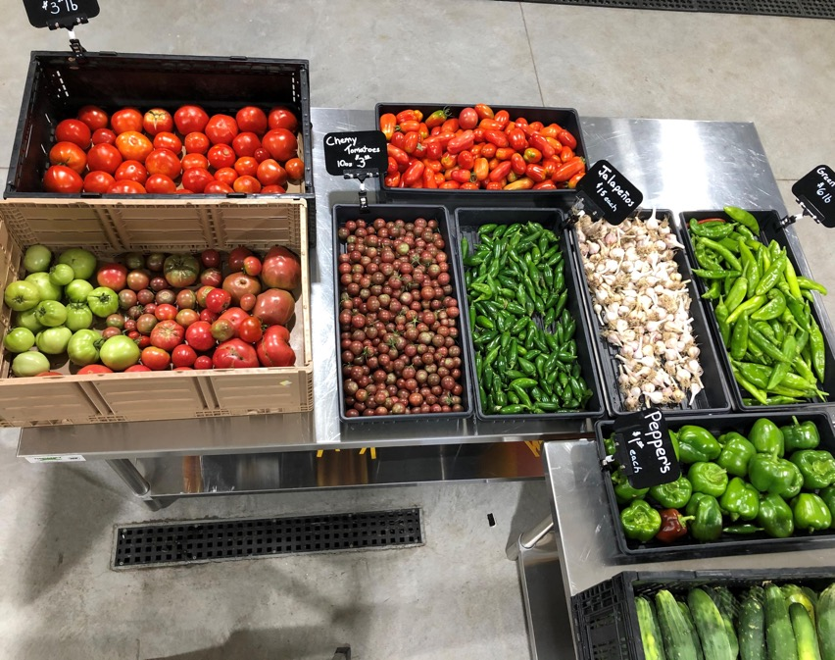
2021-2022 Season
Permanent Farm Stand
Seasonal Employees
Good Agriculture Practices (GAP) certified
SNAP
USDA-NRCS CSP contract
Skin 1 High Tunnel

Slide 19
Collaborative effort Thank You
The residents of Hutchinson
Family and Friends
Community Foundation
Reno Co. Health Dept.
BC/BS of Kansas
KS Health Food Initiative
Network Kansas
Start up Hutch
Reno Co. E Partners
USDA/NRCS
FSA Farm Loans
Reno Co. Fire Dept.
City of Hutchinson
Smith’s Market
Alex Iseman- Iseman Design
Sprinkler Warehouse Supply
Elite Plumbing
JY Construction

Slide 20
Teck Farms
teckfarms@gmail.com
620-200-6997

Slide 21
Firefly Farm’s RISE Rooftop Operations

Slide 22
Firefly Farm
Firefly Farm is a five-acre, vintage farmstead located just one mile east of Wichita city limits. A family farm site for over 100 years, the land has been in the Garcia family since it was purchased by Bob and Violet in 1950. It is a second-generation farm now with their son, Ron, and his wife, Leah, as stewards.
www.fireflyfarmwichita.com

Slide 23
Firefly Farm
Since its launch in 2015, Firefly Farm has hosted farm-to-table dinners, a farmers’ book club, a farmers’ market, weddings, and private parties and events.
Firefly Farm has focused on heirloom vegetables, specifically, heirloom tomatoes on which it has built its reputation.

Slide 24
Firefly Farm
In 2020, Firefly Farm forged a connection with Tallgrass Hemp and Cannabis—contributing to the research and resurgence of hemp, Kansas’ newest and oldest fiber, grain and food crop.

Slide 25
Firefly Farm—RISE Operations
Partnering with Fidelity Bank
One of the largest roof-top farms in the Midwest
Located in the heart of downtown Wichita, Kansas. RISE Farms consists of a 15,000-square-foot urban farm and a 204-panel solar farm situated on the top floor of Fidelity Bank’s mixed-use RISE Car Park development.

Slide 26
Firefly Farm—RISE Operations—Overview
Completion in-progress
Vision:
Model for regenerative practices—including solar energy and water runoff management
Providing fresh produce in urban Wichita—currently lacking access to healthy foods
Restaurants
First Mile
Education
Partnering with Fidelity Bank’s Office of Culture & Talent on employee engagement programs

Slide 27
Firefly Farm—RISE Operations—Virtual Tour
Growing operations designed in Zones for visitor movement and flow:
Zones 1 & 2: High Traffic
Flowers
Herbs
Ornamentals

Slide 28
Firefly Farm—RISE Operations—Virtual Tour
Zones 1 & 2: High Traffic
Flowers
Herbs
Ornamentals
Earth Boxes
Irrigation feeding reserve below—absorbing upward through soil
Easily moved and managed through growing process

Slide 29
Firefly Farm—RISE Operations—Virtual Tour
Zone 3: Leafy Greens
Staggered planting for extended availability
Contracted to provide for restaurant(s)—
On-site First Mile

Slide 30
Firefly Farm—RISE Operations—Virtual Tour
Zone 4: Larger plot production—”Traditional” growing

Slide 31
Firefly Farm—RISE Operations—Virtual Tour
Growing medium:
Rooflite
Made for rooftop intensive cultivation
Weight: Remember, it’s a roof!
70% shale, heat-treated
20% sand, 10% compost
Drip irrigation…

Slide 32
Firefly Farm—RISE Operations—Virtual Tour
…Drip irrigation
“Smart: irrigation system
Remote monitoring and control

Slide 33
RISE Operations—Year-Round Production

Slide 34
RISE Operations Speeding up propagation—starting process
Seeding room/chamber
To enclosed cultivation areas

Slide 35
RISE Operations—Processing, Packing, Storage
Processing greens, produce for restaurants…
…sourcing regional Food Hub (more in next presentation)

Slide 36
RISE Operations—Vision
Restaurants
Fidelity’s plans: On-site
Ahead
Food Hub
Local urban markets addressing shortage, lack of access issues
…and beyond

Slide 37
www.fireflyfarmwichita.com

Slide 38
Food Safety Considerations
At each stage of a grower’s evolution—
Planning ahead for food safety requirements
Not an inclusive formal food safety training—We’ll look at the evolution in production and sales of our two partner growers, and practical steps in their decision making in food safety planning and implementation—highlighting FSMA, GAP, and KDA options in general scope.
Intended to help growers figure out the questions—we may not have all the answers.

Slide 39
Evolution in cultivation and sales = Evolution in training, certification, and licenses
FSMA
Kansas Department of Agriculture
GAP

Slide 40
TITLE 21—FOOD AND DRUGS Part 112—Standards for the Growing, Harvesting, Packing, and Holding of Produce for Human Consumption
Food Safety Modernization Act:
FSMA

Slide 41
Food Safety Modernization Act:
FSMA
Do you need it?
From:

Slide 42
Food Safety Modernization Act:
FSMA
Does your farm grow, harvest, pack or hold produce?
Sec. 112.1 What food is covered by this part?
…covered produce includes all of the following:
Fruits and vegetables such as almonds, apples, apricots, apriums, Artichokes-globe-type, Asian pears, avocados, babacos, bananas, Belgian endive, blackberries, blueberries, boysenberries, brazil nuts, broad beans, broccoli, Brussels sprouts, burdock, cabbages, Chinese cabbages (Bok Choy, mustard, and Napa), cantaloupes, carambolas, carrots, cauliflower, celeriac, celery, chayote fruit, cherries (sweet), chestnuts, chicory (roots and tops), citrus (such as clementine, grapefruit, lemons, limes, mandarin, oranges, tangerines, tangors, and uniq fruit), cowpea beans, cress-garden, cucumbers, curly endive, currants, dandelion leaves, fennel-Florence, garlic, genip, gooseberries, grapes, green beans, guavas, herbs (such as basil, chives, cilantro, oregano, and parsley), honeydew, huckleberries, Jerusalem artichokes, kale, kiwifruit, kohlrabi, kumquats, leek, lettuce, lychees, macadamia nuts, mangos, other melons (such as Canary, Crenshaw and Persian), mulberries, mushrooms, mustard greens, nectarines, onions, papayas, parsnips, passion fruit, peaches, pears, peas, peas-pigeon, peppers (such as bell and hot), pine nuts, pineapples, plantains, plums, plumcots, quince, radishes, raspberries, rhubarb, rutabagas, scallions, shallots, snow peas, soursop, spinach, sprouts (such as alfalfa and mung bean), strawberries, summer squash (such as patty pan, yellow and zucchini), sweetsop, Swiss chard, taro, tomatoes, turmeric, turnips (roots and tops), walnuts, watercress, watermelons, and yams;
Yes?....

Slide 43
Food Safety Modernization Act:
FSMA
Is your produce one of the commodities that FDA has identified as rarely consumed raw?
Sec. 112.2 What produce is not covered?…list
Note: If you grow, harvest, pack or hold more than one produce commodity, you must ask this question separately for each one to determine whether that particular produce commodity is covered by this rule.
No?...

Slide 44
Food Safety Modernization Act:
FSMA
Does your farm on average (in the previous three years) have more than $25k in annual produce sales?
Yes?…

Slide 45
Food Safety Modernization Act:
FSMA
(Your) produce receives commercial processing that adequately reduces the presence of microorganisms of public health significance. Examples…(include)…processing such as refining, distilling, or otherwise manufacturing/processing produce into products such as sugar, oil, spirits, wine, beer or similar products…
No?...

Slide 46
Food Safety Modernization Act:
FSMA
You need it—
Generally broad:
.
Sec. 112.11 What general requirements apply to persons who are subject to this part?
You must take appropriate measures to minimize the risk of serious adverse health consequences or death from the use of, or exposure to, covered produce… Terms such as “reasonable measures,” “at a minimum,” must adequately maintain, etc.

Slide 47
Food Safety Modernization Act:
FSMA
Training
Firefly—exemplary of requirements: Managers take training sessions offered (throughout state, Extension), and then train their employees related to their production and processing
Compliance—TITLE 21—FOOD AND DRUGS, Part 112—will be posted on follow up webpage
Inspection
Random—all growers subject to (from public records)
To date:
Focusing on larger farms
Emphasizing education, not penalties

Slide 48
Food Safety Modernization Act:
FSMA
Other reasons to take FSMA training?
Teck: Educate yourself!
Teck: Starting point to develop best practices and plan ahead
Because it’s the right thing to do!
One incident will have repercussions on the industry as a whole

Slide 49
Kansas Department
of Agriculture
Licensure exemptions include (pertaining to our industry):
Foods that are ALLOWED to be sold directly to consumers in Kansas WITHOUT licensing, according to state regulations:
Fresh (or dried or freeze-dried) uncut fruits, vegetables (not cut beyond normal harvesting)… Intact salad greens (not cut beyond normal harvesting)…* Farmers Markets, On-site Sales, etc.
K-State Research and Extension/KS Dept of Agriculture—Foods Sold Direct to Consumers in Kansas: Regulations and Food Safety Best Practices

Slide 50
Kansas Department
of Agriculture
—cont’ed:
*Cut leafy greens (fresh or dried)……cut tomatoes, cut melons…cut beyond normal harvesting…
KDA Food Establishment License required for production facility and point of sale
Food establishment applies to a businesses that prepares or offers food for immediate consumption…(including) restaurants, events, mobile food units…schools… (Teck, Firefly)
K-State Research and Extension/KS Dept of Agriculture—Foods Sold Direct to Consumers in Kansas: Regulations and Food Safety Best Practices

Slide 51
Kansas Department
of Agriculture
Licensure exemptions include (pertaining to our industry):
Certain cut produce and cut herbs are exempt…berries, carrots, herbs…
Home-canned fruit jams and jellies
Educate yourself!
K-State Research and Extension/KS Dept of Agriculture—Foods Sold Direct to Consumers in Kansas: Regulations and Food Safety Best Practices

Slide 52
Kansas Department
of Agriculture
Food Processor/Food Storage License
Processor…manufacturing, preparing, packaging, labeling, cooking, canning, extracting, extruding, fermenting, distilling, pickling, freezing, baking, drying, smoking, grinding, cutting, mixing, coating, stuffing…or any other treatment or preservation process…for sale or distribution to other business entities (again—for immediate consumption—Establishment)
You may be required to have both (Firefly/RISE and Teck)
https://agriculture.ks.gov/divisions-programs/food-safety-lodging/food-safety-licenses

Slide 53
Kansas Department
of Agriculture
Licensure exemptions include (pertaining to our industry):
Prepared food 6x or less (in a year) exemption (Firefly)
Educate yourself!
K-State Research and Extension/KS Dept of Agriculture—Foods Sold Direct to Consumers in Kansas: Regulations and Food Safety Best Practices

Slide 54
Kansas Department
of Agriculture
Food Processor/Food Storage License
Storing…for distribution to other wholesalers, retail food stores, food service establishments or any other facility that sells or distributes to the ultimate consumer. (Looking ahead—Firefly)
If you do both—do not need two separate licenses
https://agriculture.ks.gov/divisions-programs/food-safety-lodging/food-safety-licenses

Slide 55
Kansas Department
of Agriculture
Process:
Application for Processor/Storage—based on square feet of your facility—starts at ~$325 first year, reduced subsequent years
Application for Establishment—$200
Compliance
Inspection—Growers’ experience?
https://agriculture.ks.gov/divisions-programs/food-safety-lodging/food-safety-licenses

Slide 56
GAP
USDA Good Agricultural Practices
Voluntary audits that verify that fruits and vegetables are produced, packed, handled, and stored to minimize risks of microbial food safety hazards. (USDA—Good Agricultural Practices Audits)
You pay for audits

Slide 57
GAP
USDA Good Agricultural Practices
Seven Parts—including:
Farm Review
Field Harvest and Field Packing Activities
House Packing Facility
Storage and Transportation
Wholesale Distribution Center/Terminal Warehouses Receiving—discontinued
July 31 2022—replaced with Good Manufacturing Practices (GMP) audit
service for produce distribution centers.

Slide 58
GAP
USDA Good Agricultural Practices
Quickly mention: Group GAP: Random members of your group are audited—cost shared
Mutual trust and commitment required

Slide 59
GAP
If voluntary—Motivation to do it?
It’s the right thing to do—good practices
May open avenues for expanded distribution
Sometimes DOES open possibilities
Teck’s experience—required for school meal subsidies program
Firefly: Looking ahead—taking lead role in regional food hub, positioning themselves to expand inputs and distribution
Collective system, providing scale and reducing costs for their suppliers
Taking the early initiative—set standards

Slide 60
GAP
Educate yourself
Advised not to get GAP proactively for specific target distribution sources (restaurant, grocery store, etc.)—unless you know they require it

Slide 61
Let’s see it in practice— Not in any way an inclusive list—but demonstrating tone of regulations, practices, equipment, infrastructure toward food safety req’s.
FSMA
Kansas Department of Agriculture
GAP

Slide 62
Climate-controlled rooms are monitored for temperature and logs are maintained
(GAP Part 4: STORAGE AND TRANSPORTATION)

Slide 63
You must use food-packing material that is adequate for its intended use, which includes being:
Cleanable or designed for single use; and
Unlikely to support growth or transfer of bacteria.
(FDA—FSMA: Sec. 112.116)
Packing containers are properly stored…to be protected from contamination
(GAP Part 4 - STORAGE AND TRANSPORTATION)

Slide 64
You must provide adequate drainage in all areas where normal operations release or discharge water or other liquid waste on the ground or floor of the building.
(FDA—FSMA: Sec. 112.126)
Possible wastewater spillage is prevented from contaminating any food handling area by barriers, drains, or sufficient distance.
(GAP Part 4: STORAGE AND TRANSPORTATION)
Floor drains appear to be free of obstructions.
(GAP Part 3: HOUSE PACKING FACILITY)

Slide 65
Employee facilities are clean and located away from packing area.
(GAP Part 3: HOUSE PACKING FACILITY)
You must provide personnel with adequate, readily accessible toilet facilities, including toilet facilities readily accessible to growing areas during harvesting activities.
Your toilet facilities must be designed, located, and maintained to: Prevent contamination of covered produce, food contact surfaces, areas used for a covered activity, water sources, and water distribution systems with human waste….
(FDA—FSMA: Sec. 112.129)

Slide 66
Packing materials used in…field pack operations are properly stored and protected from contamination.
(GAP Part 2 - Field Harvest and Field Packing Activities)

Slide 67
Food contact surfaces are in good condition; cleaned and/or sanitized prior to use and cleaning logs are maintained.
(GAP Part 3 - HOUSE PACKING FACILITY)

Slide 68
3-vat sink clean, not greasy (wash, rinse, sanitize)—KDA Self Inspection Checklist You must…clean and, when necessary and appropriate, sanitize all food contact surfaces of equipment and tools used in covered activities as frequently as reasonably necessary to protect against contamination of covered produce.—(FDA—FSMA: Sec. 112.123)

Slide 69
This has been a broad overview. Research and reach out for guidance for your food safety planning References and contact info for resources will be available on our website…
…and much more…

Slide 70
THANKS!
teckfarms.com
fireflyfarmwichita.com
kscga.org
kansasfarmersunion.com

